Slide 1

CSC 4227 Digital Image Processing
Lecture 18 – Image Restoration : Noise Removal
Dr. Kazi A Kalpoma
Professor , Dept. of CSE
Ahsanullah University of Science & Technology (AUST)
Contact: kalpoma@aust.edu
CSE | AUST
Fall 2019
Notes:
kalpoma@gmail.com

Slide 2
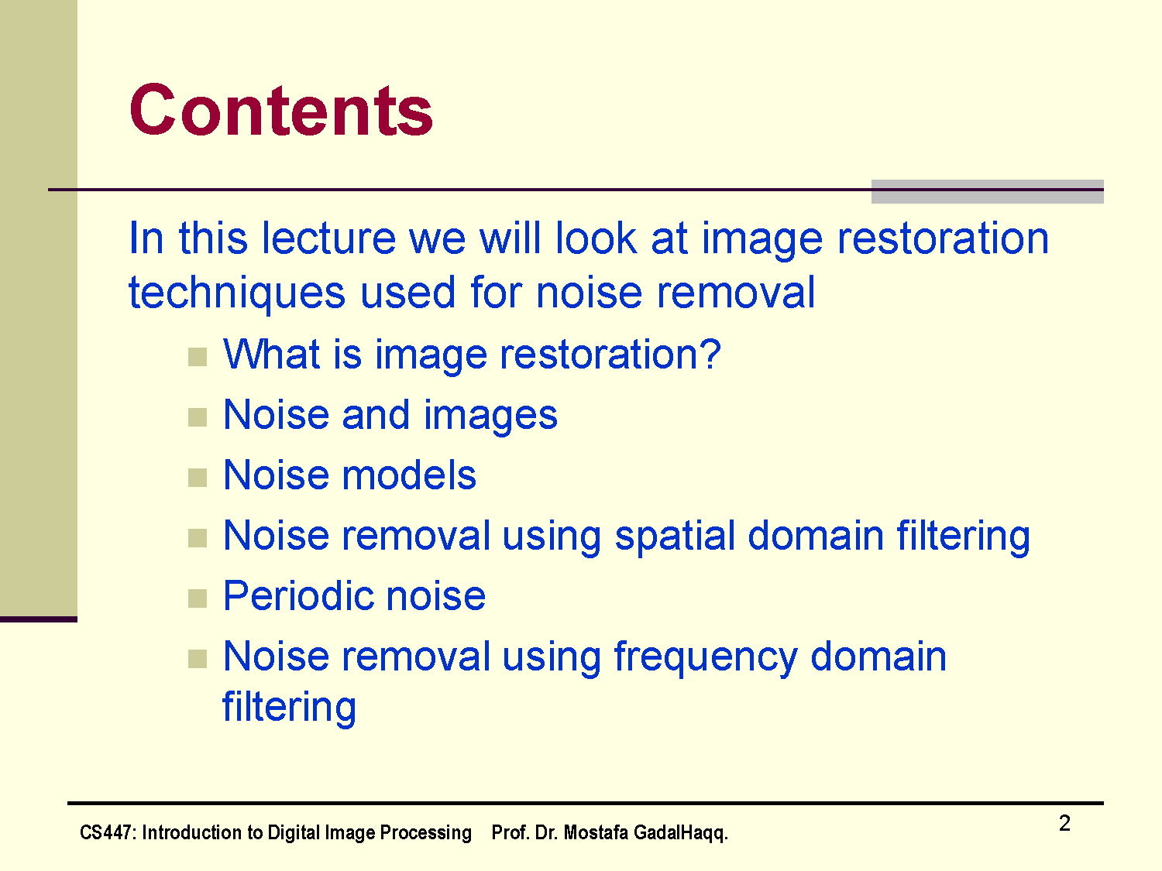
The PPT is designed with the help of different materials of other authors.

Slide 3
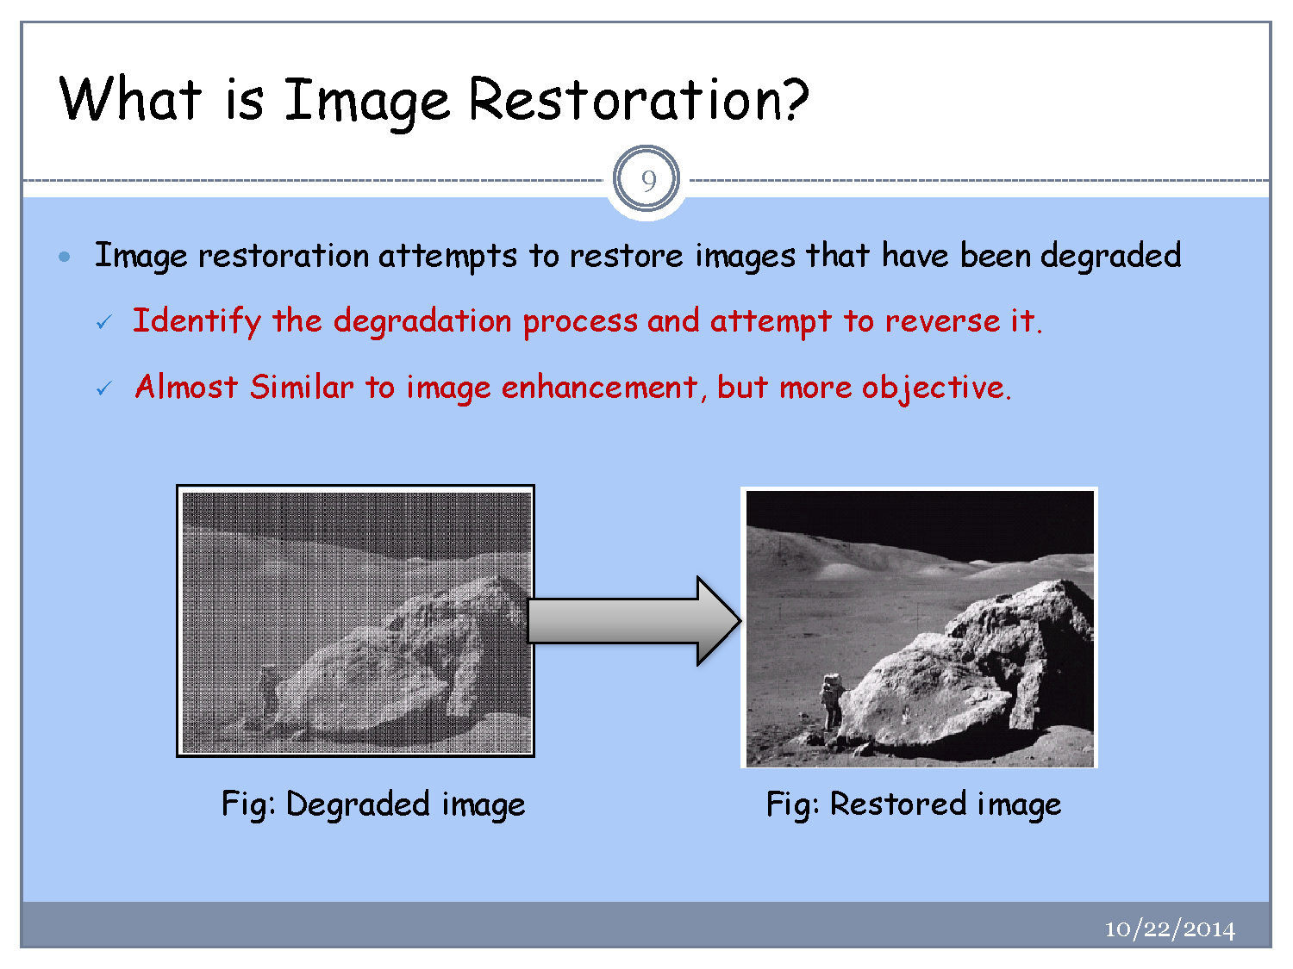

Slide 4
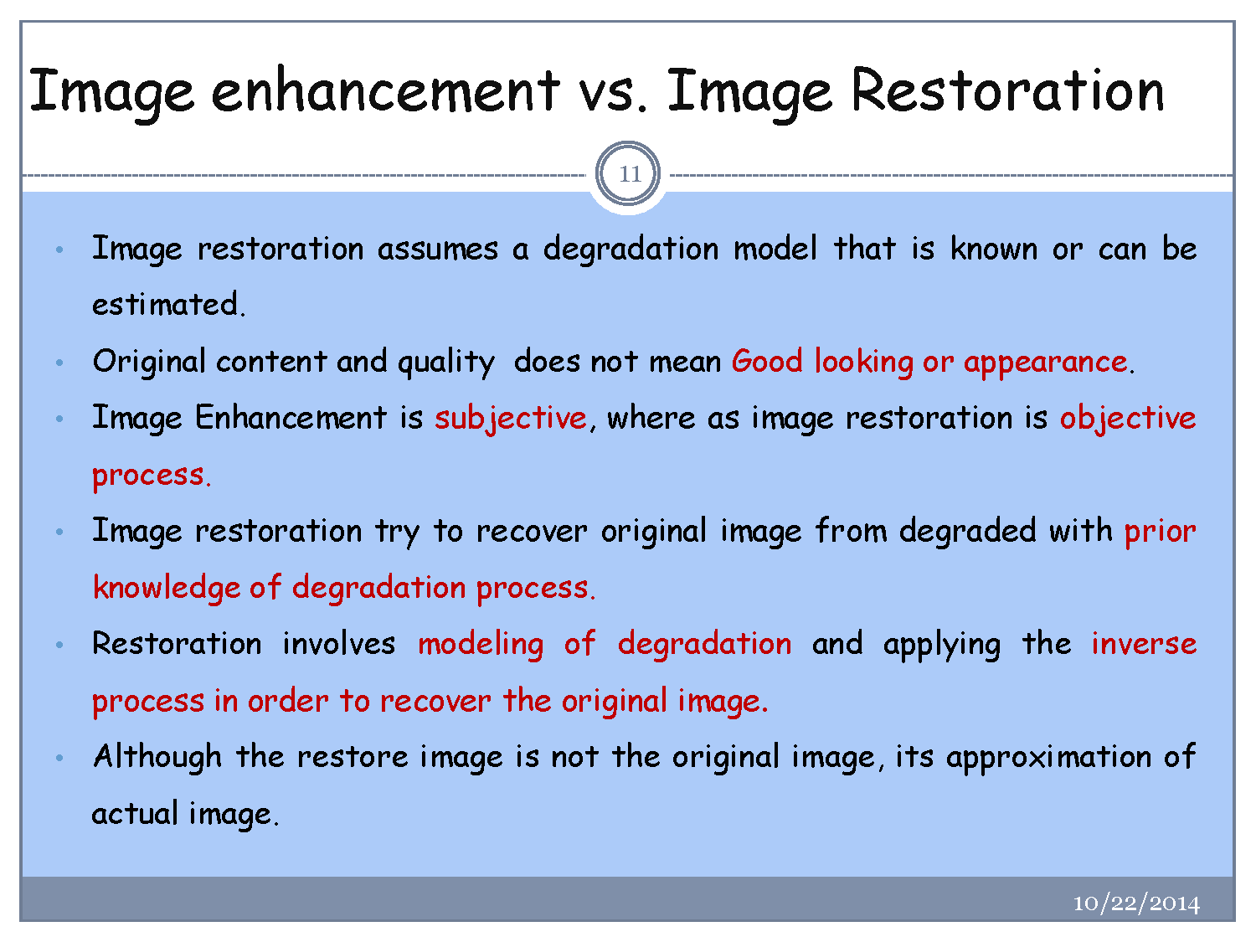

Slide 5
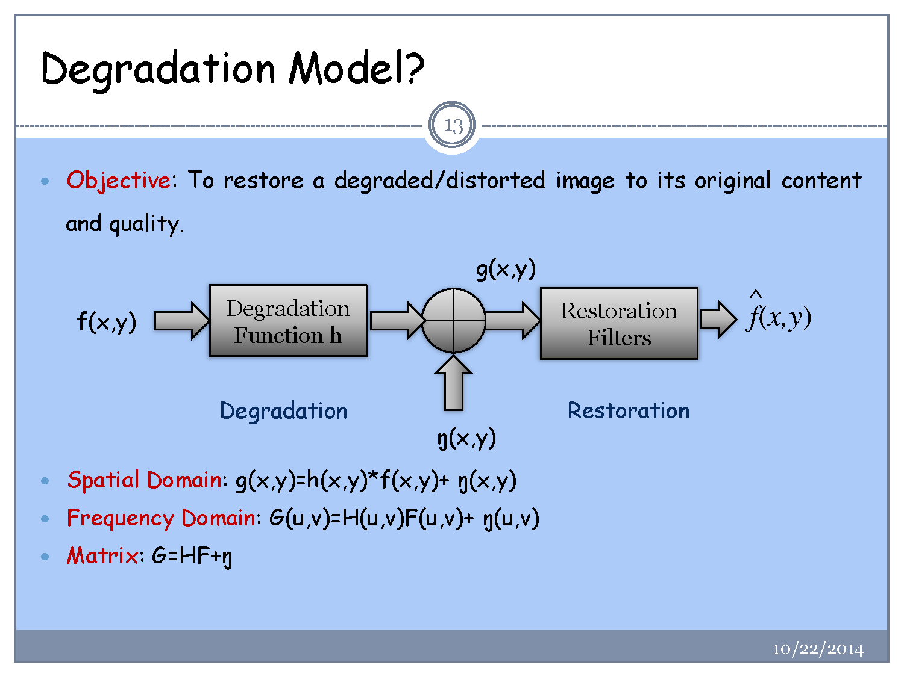

Slide 6
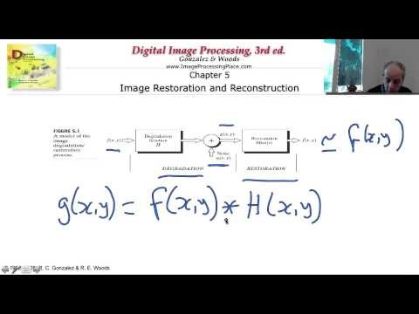
What is Image Restoration
https://www.youtube.com/watch?v=AHOV4507GBQ

Slide 7
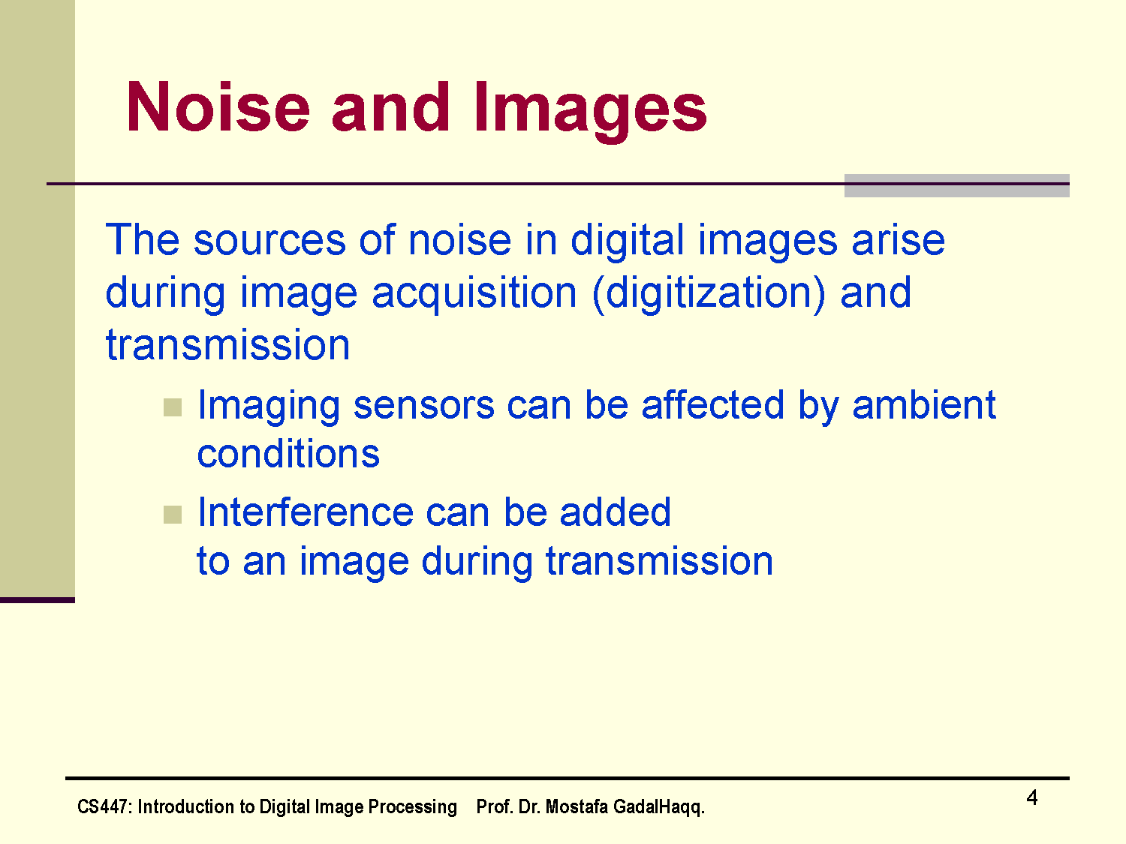
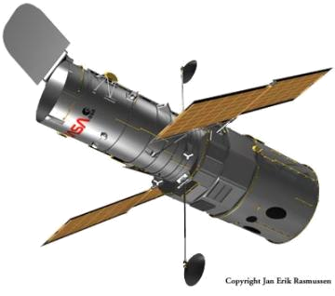
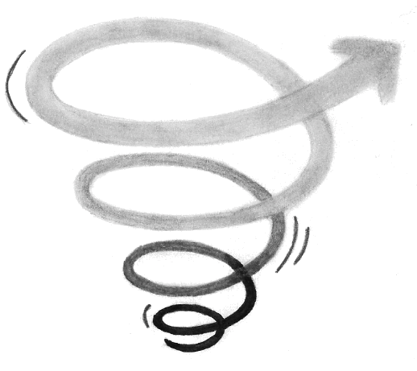

The sources of noise in digital images arise during image acquisition (digitization) and transmission
  Imaging sensors can be affected by ambient conditions
  Interference can be added
  to an image during transmission

Slide 8
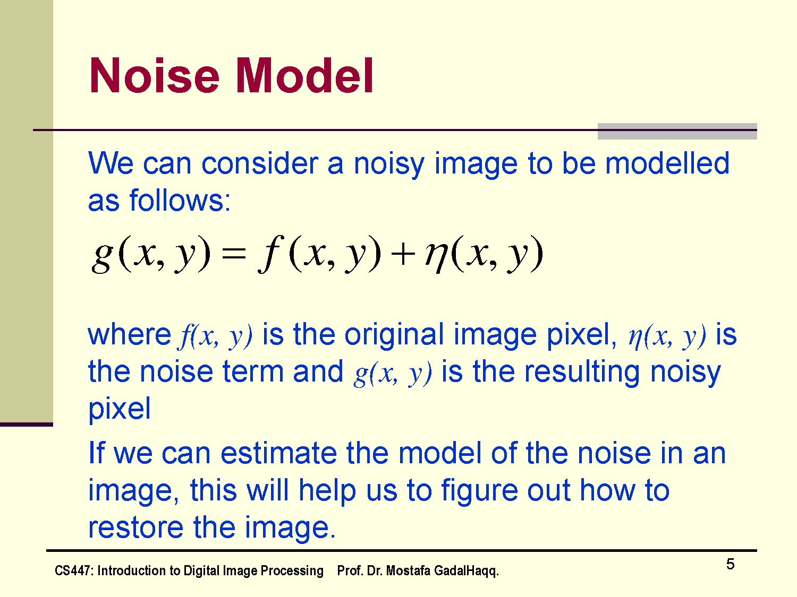

Slide 9
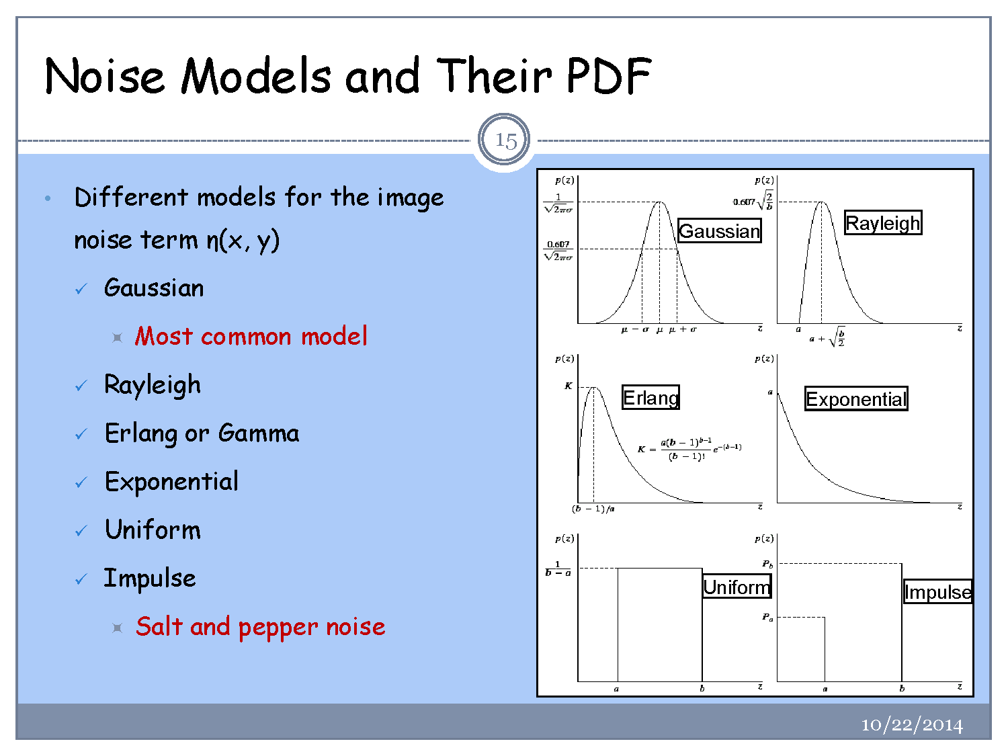

Slide 10
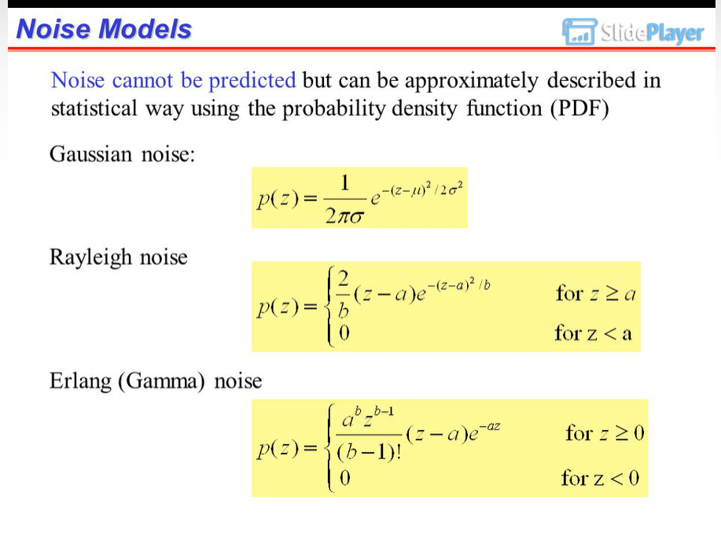

Slide 11
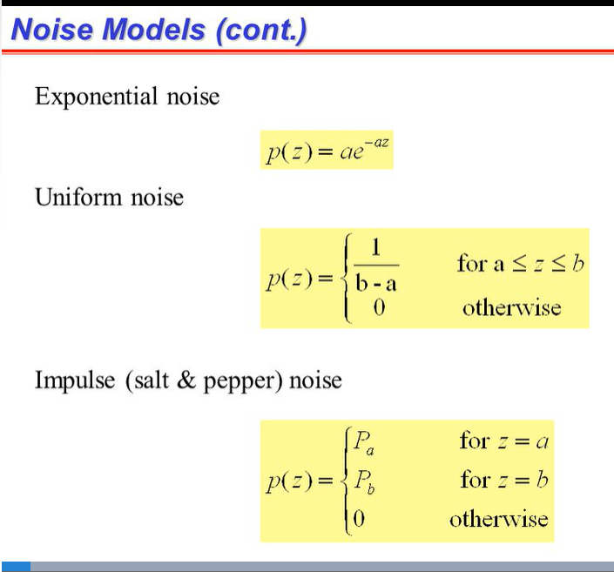

Slide 12
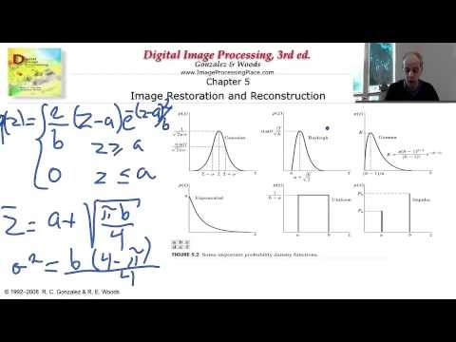
Noise Types (optional to watch)
https://www.youtube.com/watch?v=vZNyZgdEhgQ

Slide 13
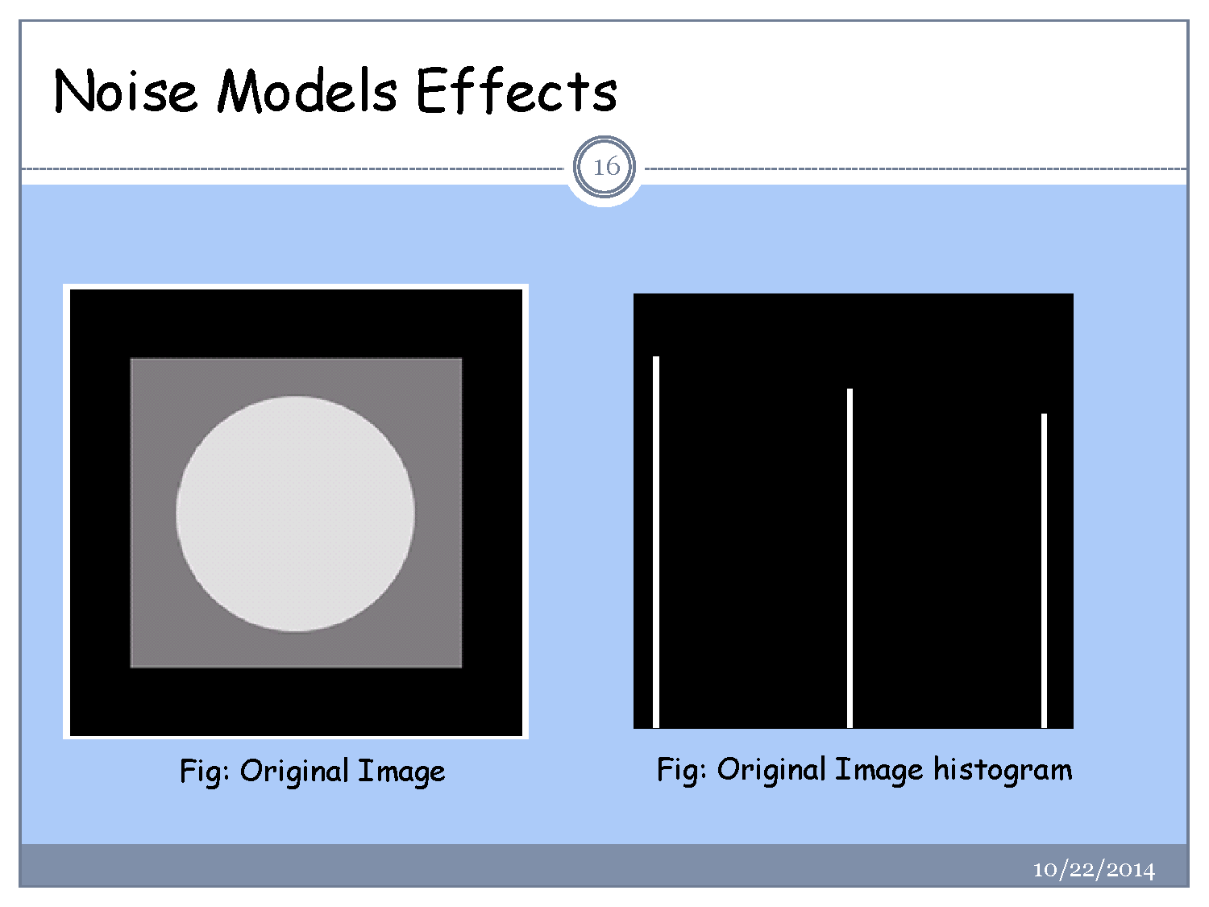

Slide 14
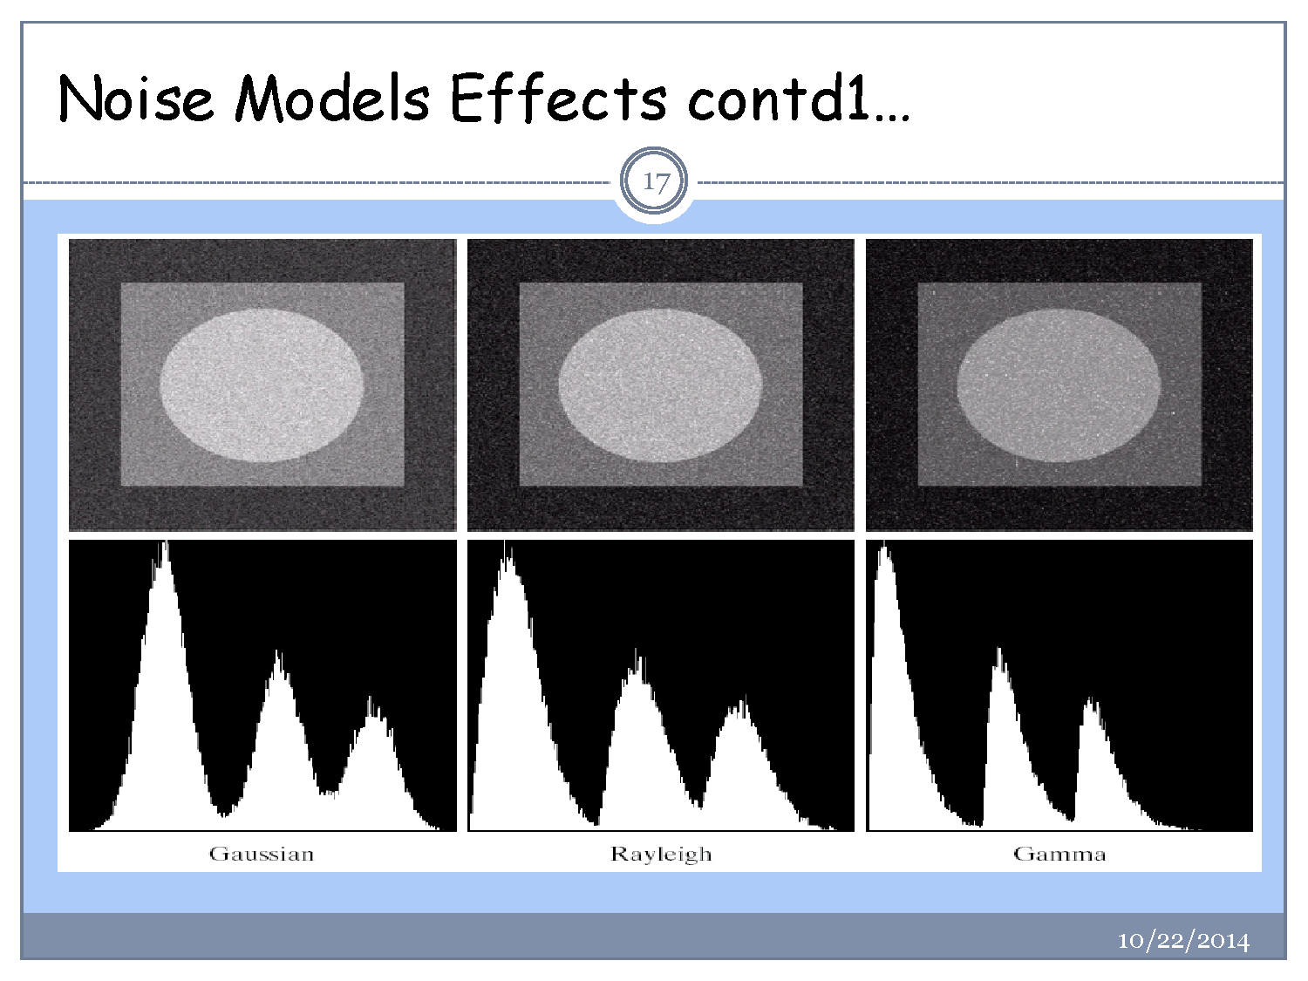

Slide 15
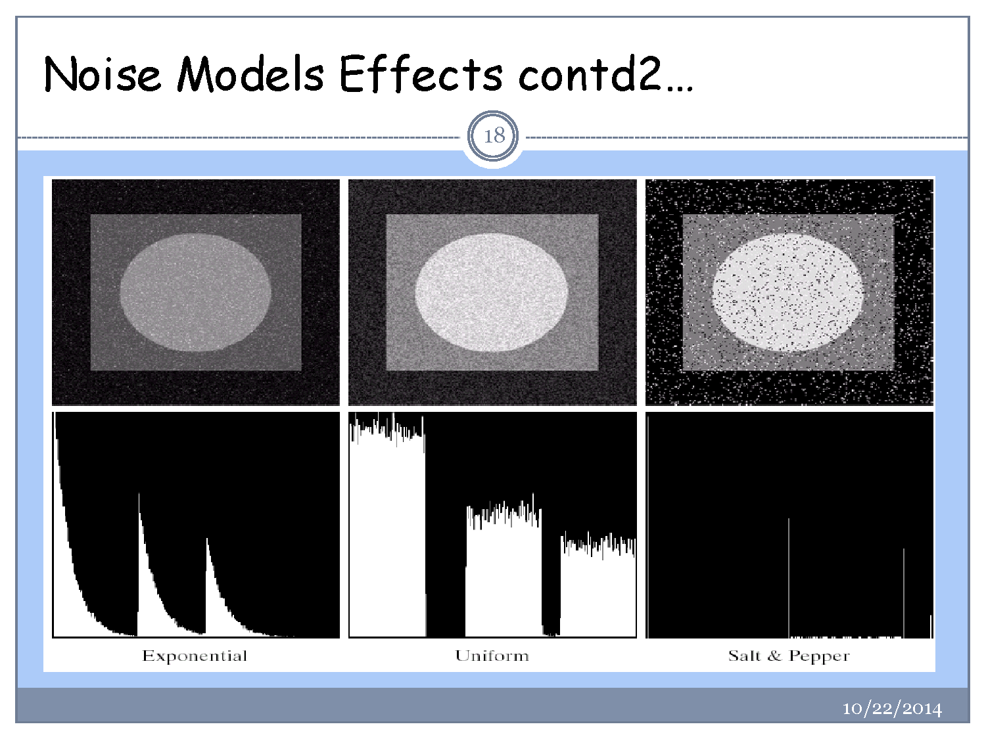

Slide 16
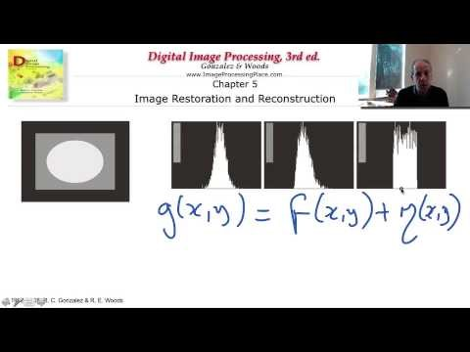
Estimating noise
https://www.youtube.com/watch?v=CIa60r2E2VI

Slide 17
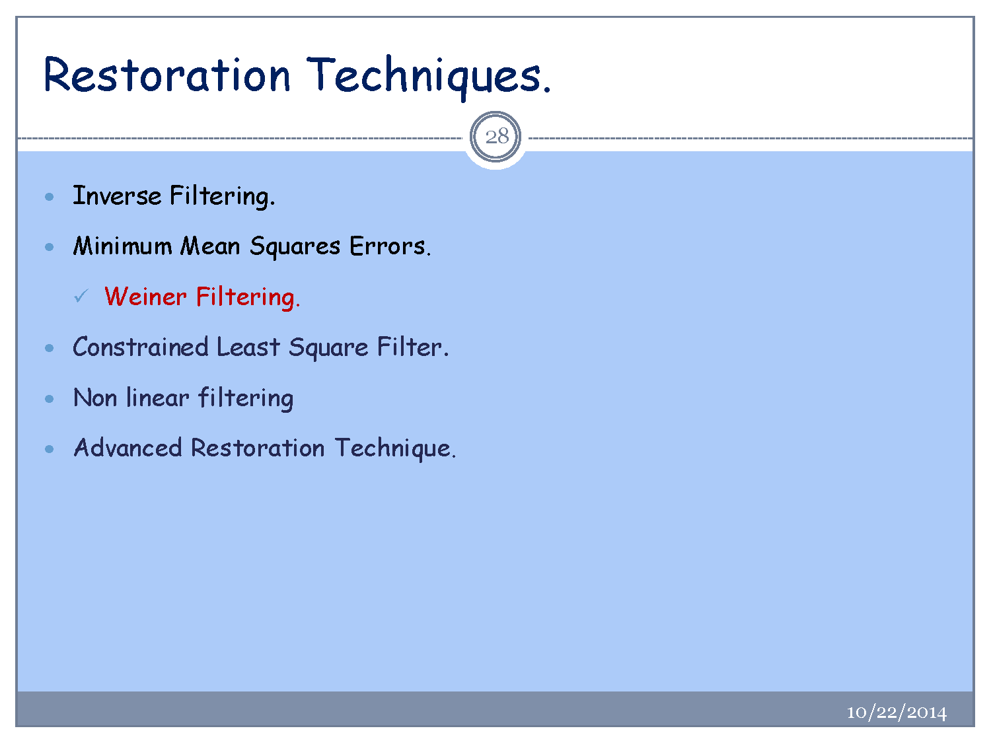

Slide 18
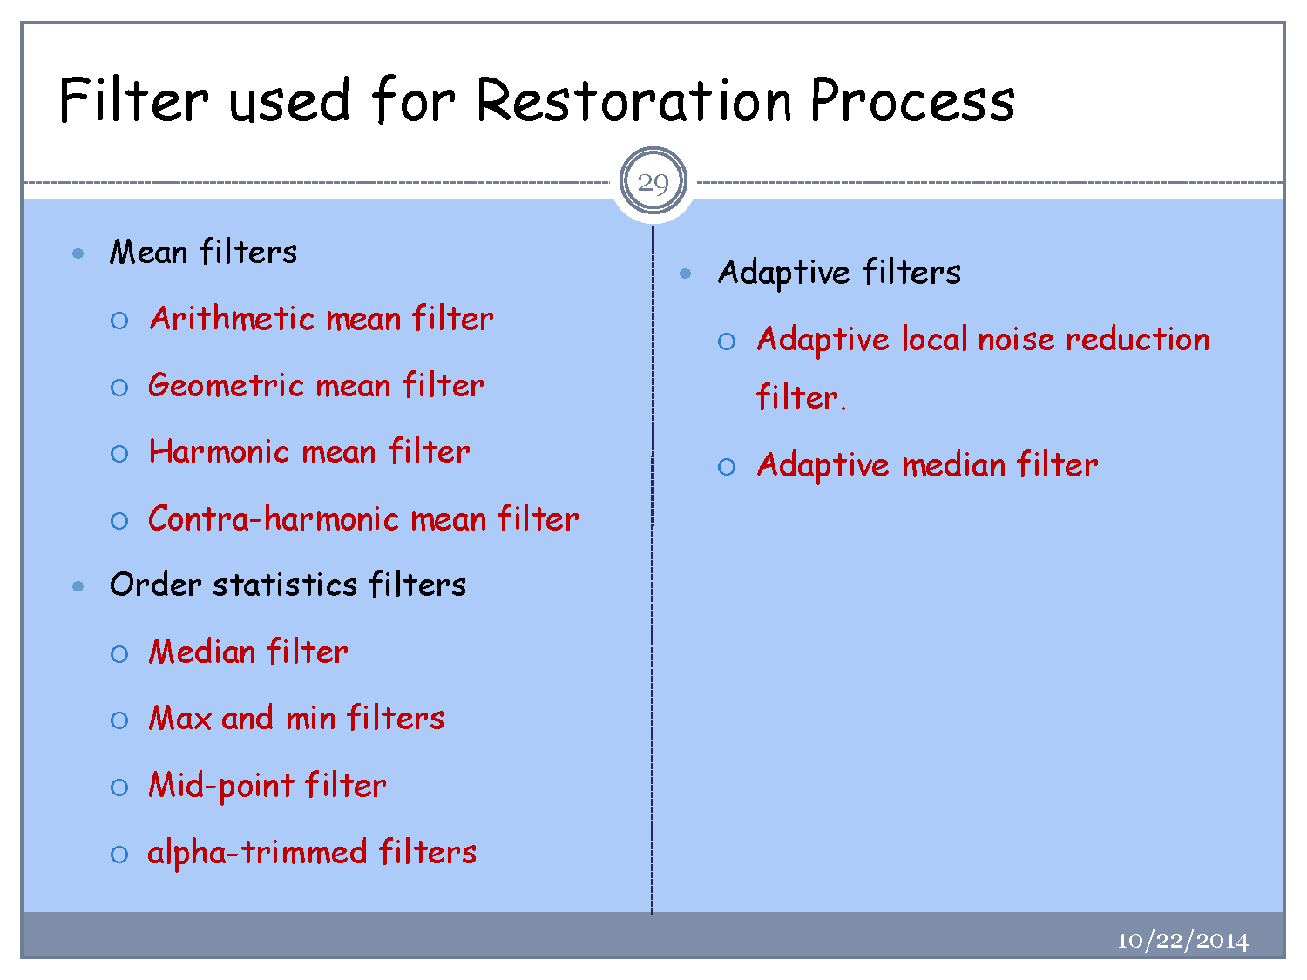

Slide 19
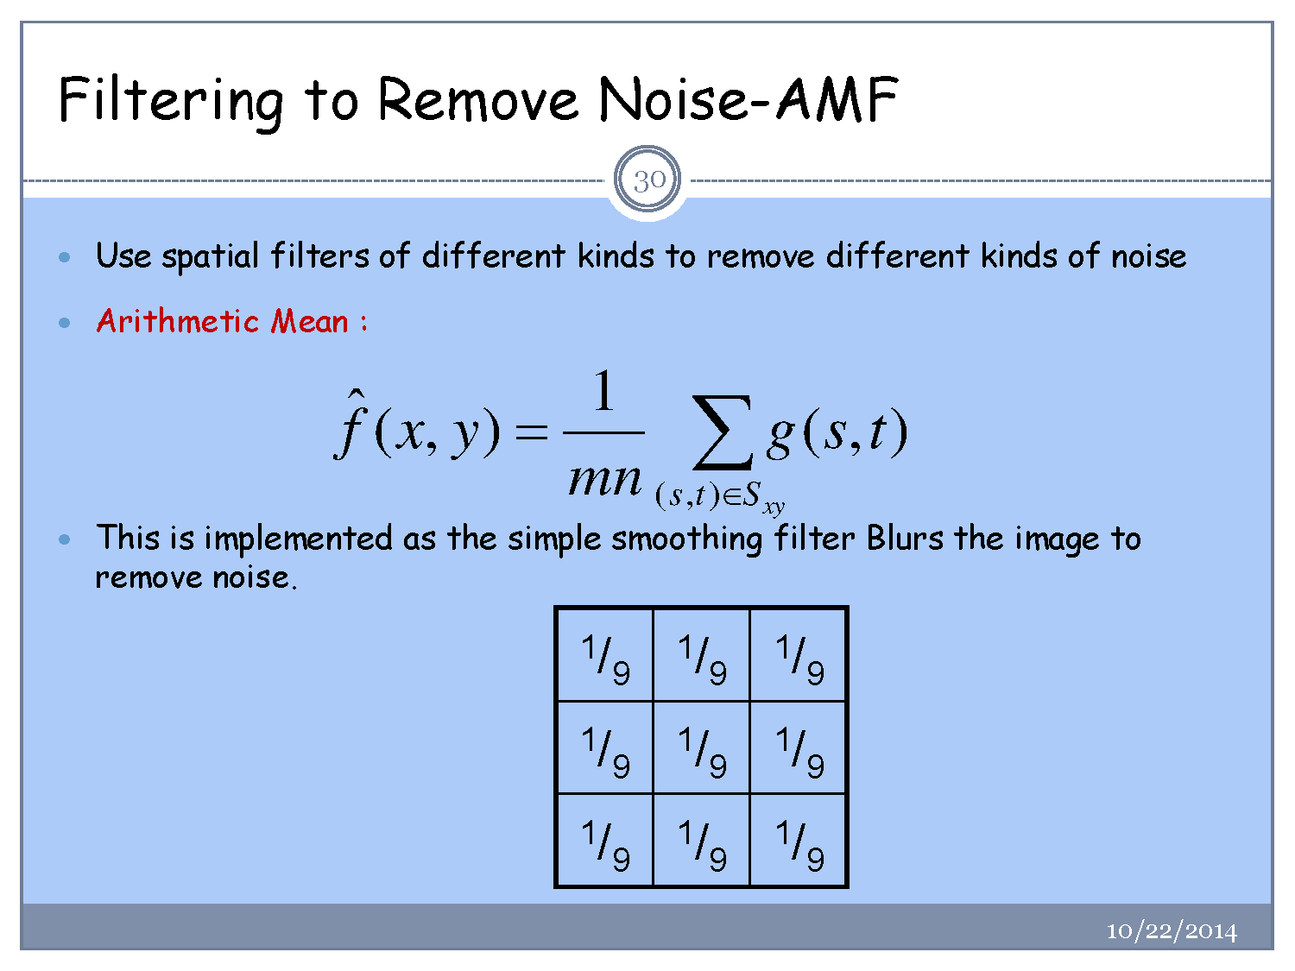

Slide 20
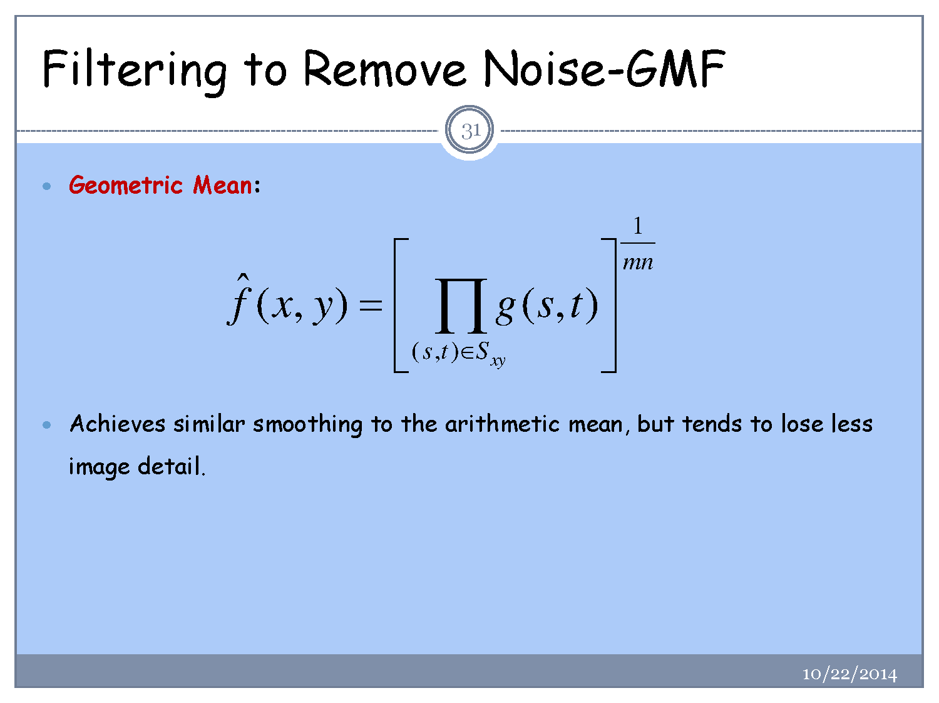

Slide 21
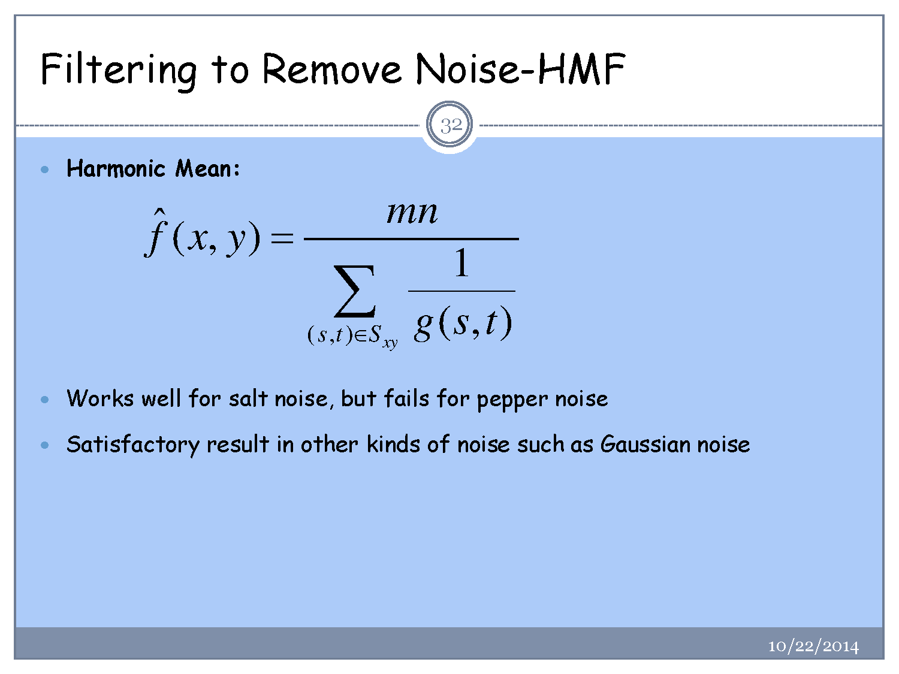

Slide 22
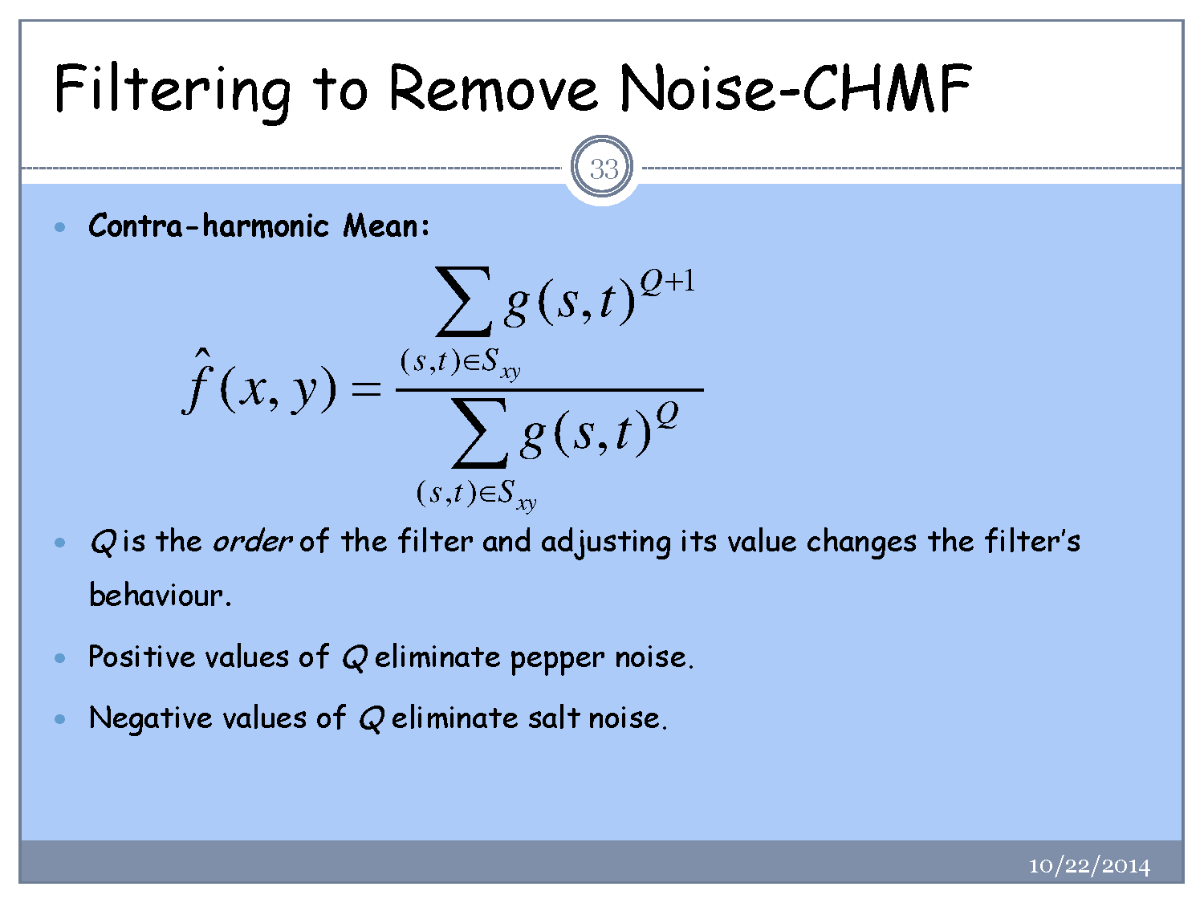

Slide 23
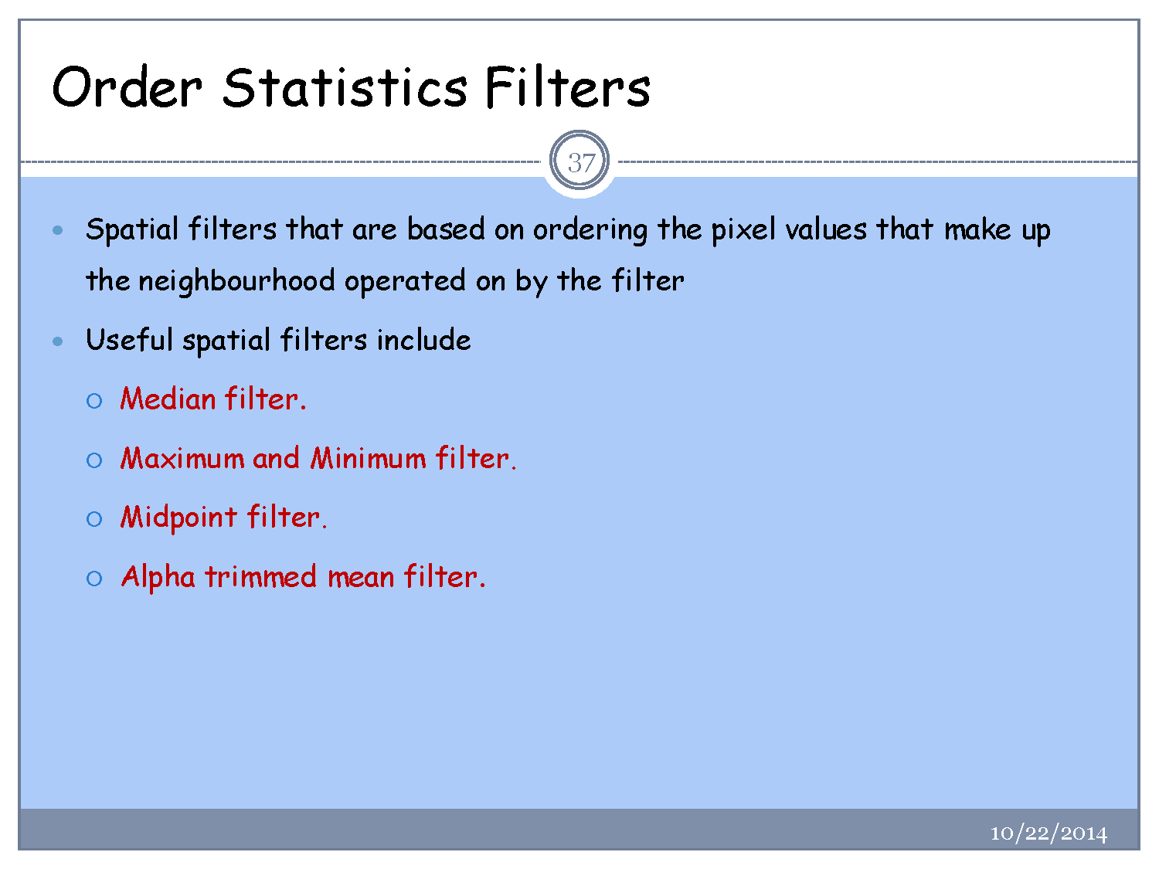

Slide 24
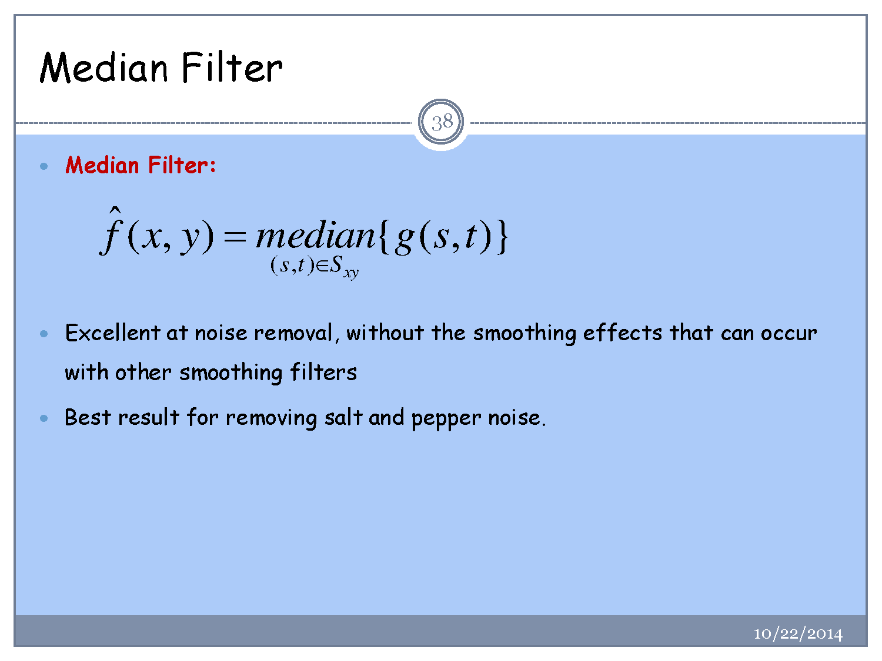

Slide 25
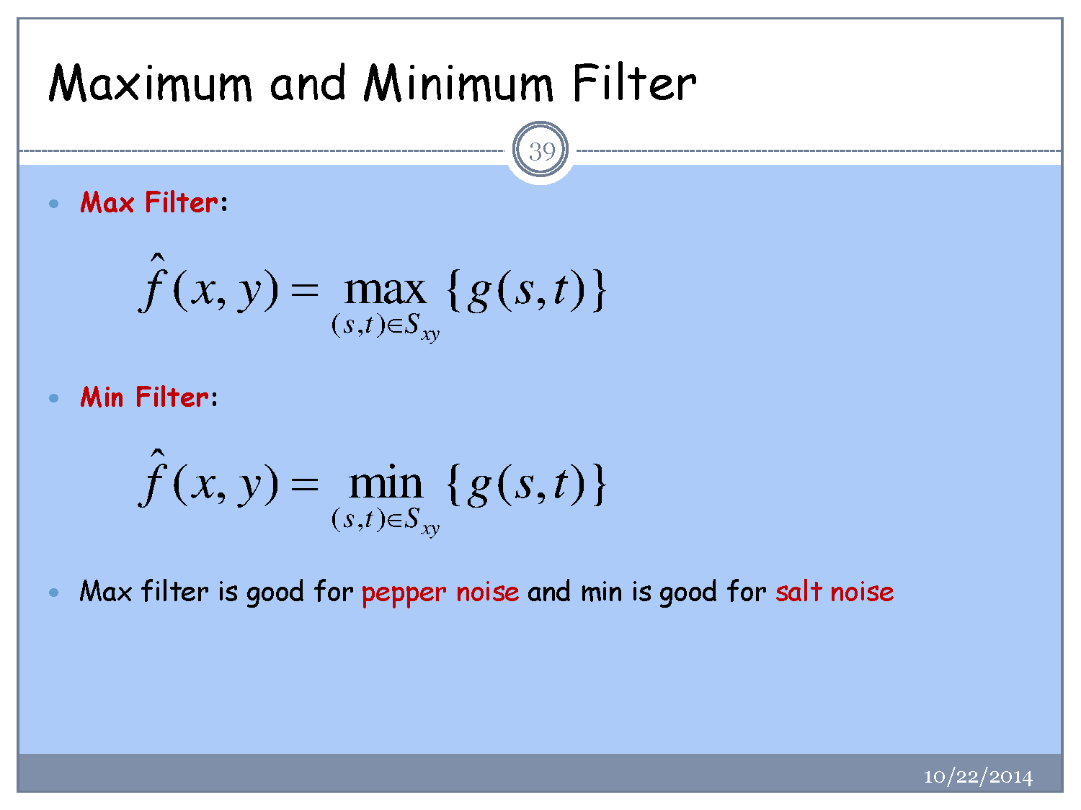

Slide 26
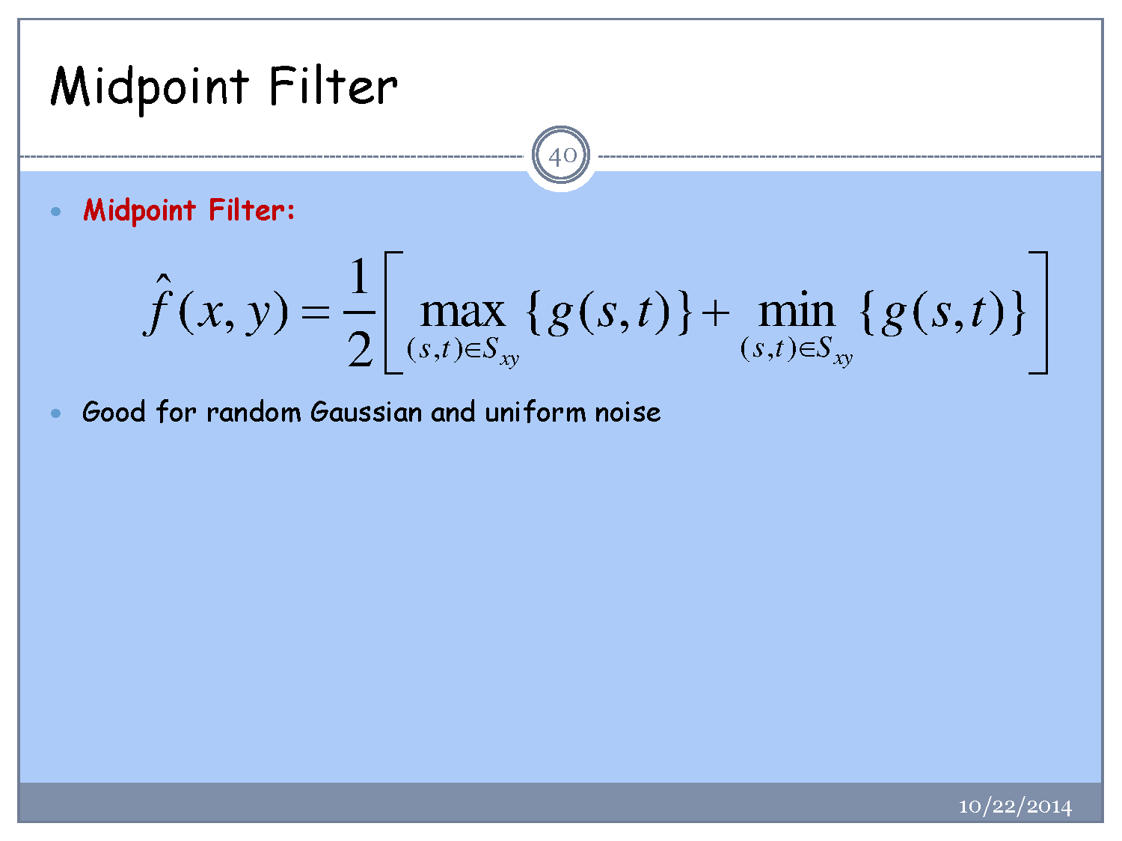

Slide 27
